Slide 1
Chapter 5

Slide 2
Objectives

Slide 3
Objectives (cont.)

Slide 4
Testing vs. debugging

Slide 5
The three types of errors that can occur

Slide 6
The Future Value application with a logic error

Slide 7
Common syntax errors

Slide 8
Problems with HTML references

Slide 9
Problems with data and comparisons

Slide 10
Problems with floating-point arithmetic

Slide 11
Problems with undeclared variables that are treated as global variables

Slide 12
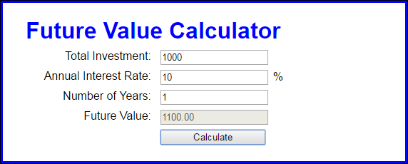
The Future Value application with valid data

Slide 13
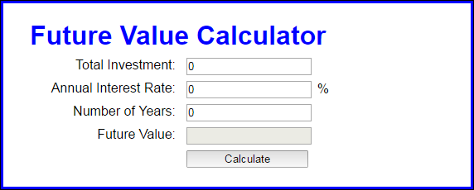
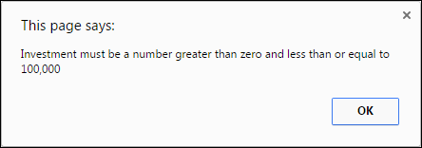
The Future Value application with invalid data

Slide 14
The two critical test phases

Slide 15
Two common testing problems

Slide 16
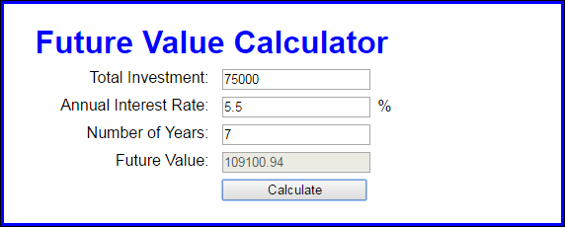
The user interface for a Future Value application

Slide 17
Top-down coding and testing

Slide 18
Top-down coding and testing (cont.)

Slide 19
Terms

Slide 20
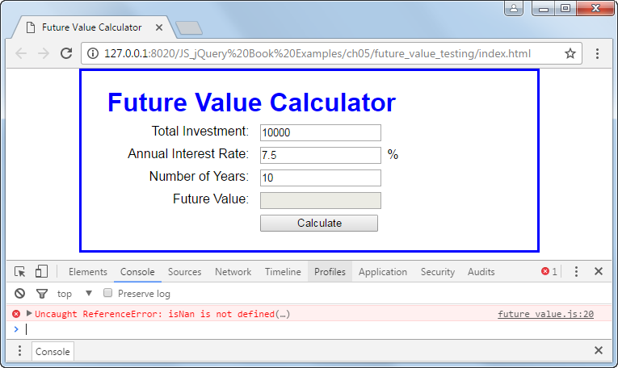
Chrome with an open Console panel that shows an error

Slide 21
Three ways to open Chrome’s developer tools

Slide 22
The Sources panel after the link in the Console panel has been clicked

Slide 23
A breakpoint in the Sources panel

Slide 24
The buttons and keys for stepping through the JavaScript code

Slide 25
How to view the current data values at each step

Slide 26
Terms

Slide 27
JavaScript with two log statements that trace the execution of the code

Slide 28
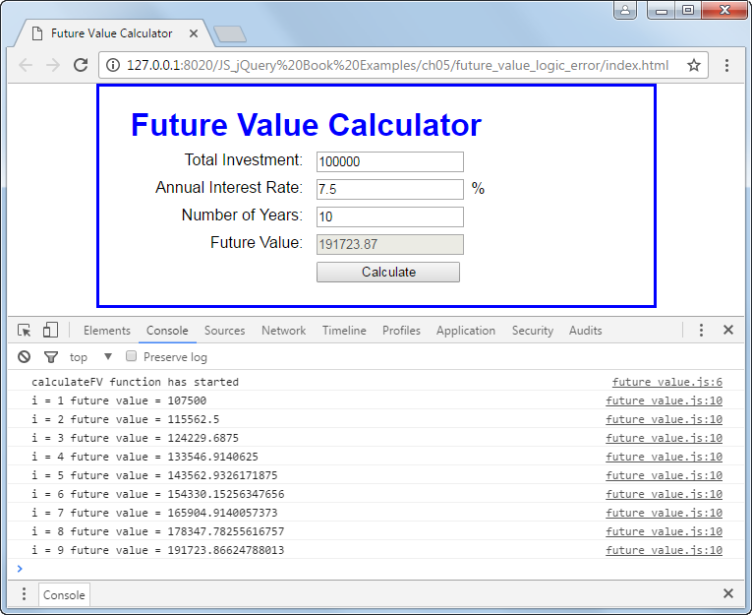
The log messages in the Console panel of Chrome’s developer tools

Slide 29
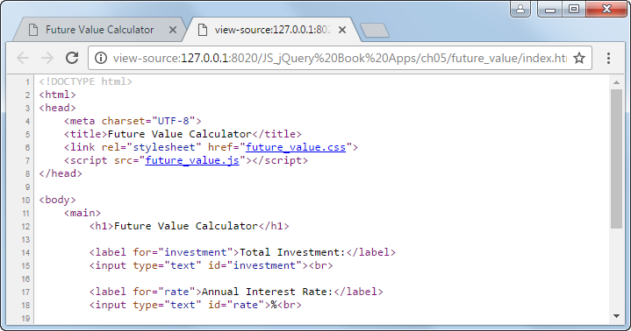
Some of the HTML in a browser

Slide 30
How to view the source code for a web page in any browser

Slide 31
Some of the JavaScript code in a browser

Slide 32
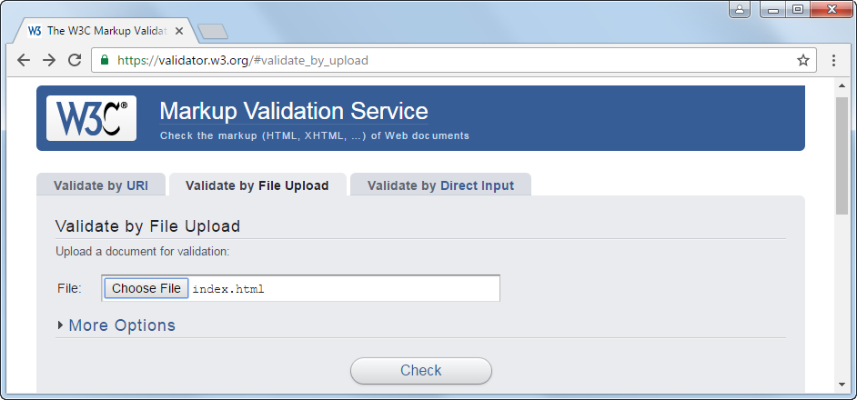
The home page for the W3C validator

Slide 33
The validation results with one error

Slide 34
How to validate an HTML file from Aptana

Slide 35
Short 5-1 Debug the Email List application

